Slide 1

CTIS 365: Applied Data Analysis
Burcu Alper
office: E114
e-mail: burcu.alper@bilkent.edu.tr

Slide 2
Course Code & Name | CTIS 365: Applied Data Analysis
Instructor | Seyid Amjad Ali office:C202 e-mail: syedali@bilkent.edu.tr
Assistant | Burcu Alper office: E114 e-mail: burcu.alper@bilkent.edu.tr
Course Grading
Type | Count | Total Contribution
In-class Participation |  | 3%
In-lab Participation |  | 3%
Homework | 2 | 8%
Lab Quiz | 3 | 12%
Lab Exam | 1 | 12%
Midterm | 1 | 20%
Term Project | 1 | 12%
Final | 1 | 30

Slide 3


Slide 4
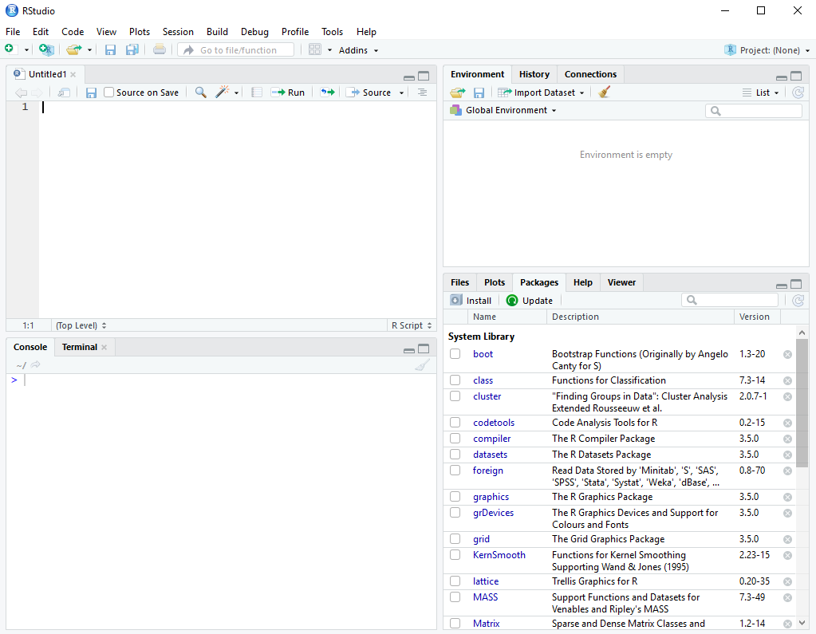

R Script
Workspace &
Environment
Console

Slide 5

Meaning of Some Symbols in R
"#": Represents a comment line in R, the code or text after this sign will not affect the code execution of the R Script.
"<-": is the assignment opperator in R.
"L" : to make sure that the variable is integer
The "^" operator raies the number to its left to the power of the number to its right.
The modulo (%%) returns the remainder of the division of the number to the left by the number on its right.

Slide 6
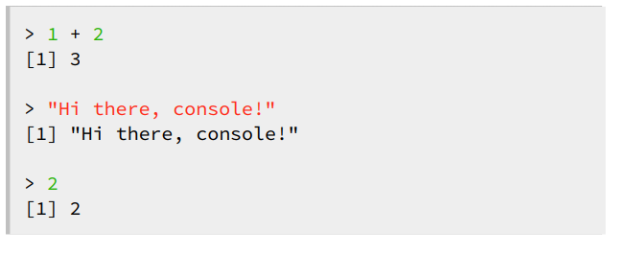
Data Input

Slide 7
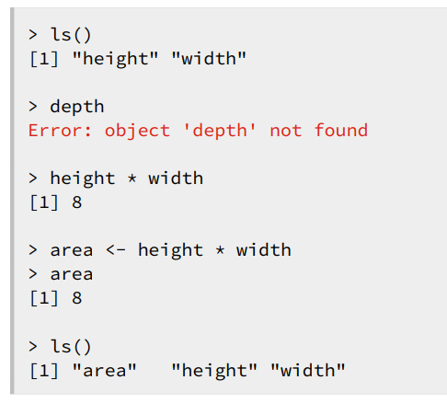
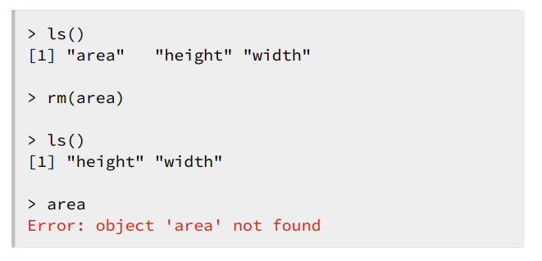
Workspace

Slide 8
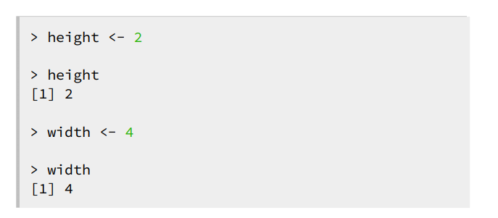
Variables
<- : Store a variable to reuse later

Slide 9
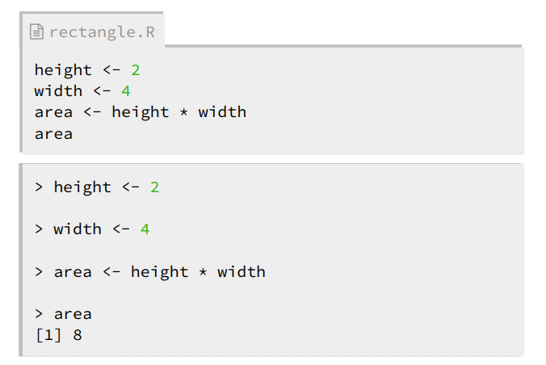
R Script
● Text file with R commands
● Automate your work

Slide 10
Functions in R
c()
rep() Creates a vector
seq()
is.numeric()
is.integer()
is.double() Returns a Boolean variable
is.character()
mean()
colSums()
rowSums()
print()
ls()
sum()
typeof()
sqrt()
paste()
as.character()
as.logical() Parses the variable (coercion)
as.integer()

Slide 11

Variable Types
Integer
x & y are variables
Types of variables?
What is L?

Slide 12

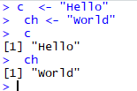
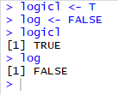
Variable Types (cont.)
Double:
Character: Logical:

Slide 13
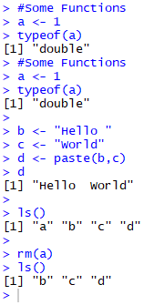
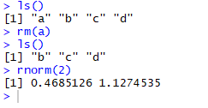
Some Functions
Once we have assigned a value and used a variable, it is always kept in memory, so when we are done using the variable, remove it from the memory.

Slide 14
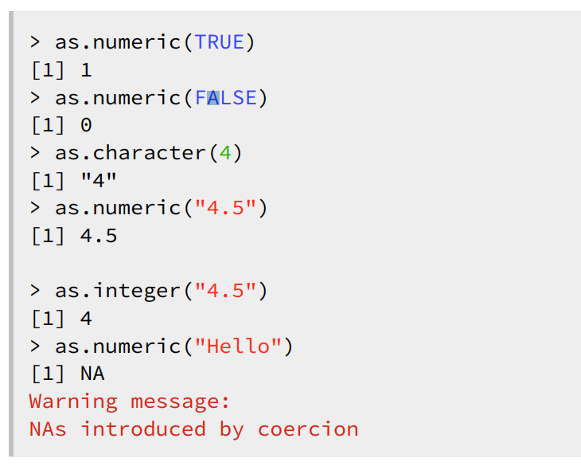
Coercion

Slide 15
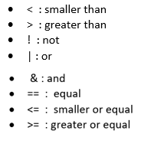
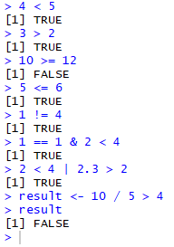
Logical Variables and Operators

Slide 16
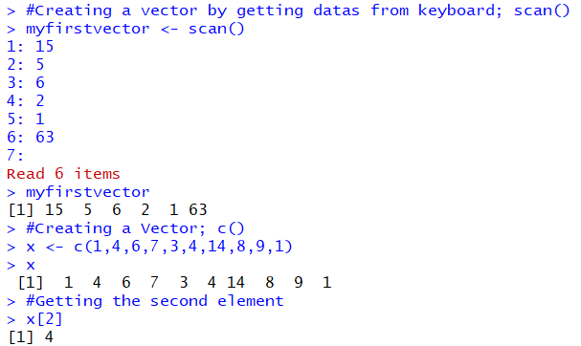
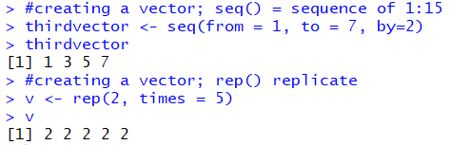
Vectors
● Sequence of data elements
● Same basic type
● Character, numeric, logical
● Vectors are homogeneous
● Only elements of the same type
● Automatic coercion if necessary

Slide 17
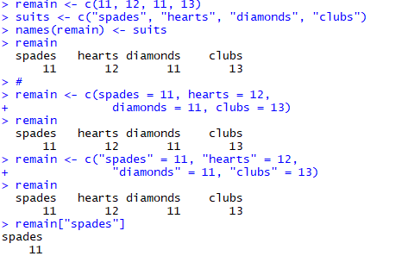
Rename a Vector Columns by Using names()

Slide 18
Vectorized Operations
Vectorized Approach
When you perform an arrhythmic operation, you can simply assign the result to another vector.
Ex:
myVectorizedvector <- myfirstvector * mysecondvector
De-Vectorized Approach
Perform the operation for all elements in the vector one by one and assign to another vector.

Slide 19
Reading a Text file to a Vector
ChrVector <- scan("nameOfFile", character(), quote = " ")
NumericVector <- scan("nameOfFile", numeric(), quote = " ")

Slide 20
Matrices
A matrix is a collection of data elements arranged in a two-dimensional rectangular layout.
Building a matrix in three way;
matrix() → It bends the vector to fit in the matrix
rbind() → Binds the vectors row wise.
cbind() → Binds the vectors column wise.

Slide 21
Naming Dimensions
We can give names for rows and columns instead of index numbers in R. Although, we can give a name for rows and columns, the indexation with numbers will stay.
Subsetting
It basically comes down to selecting parts of the matrices or vectors to end up with a new vector or new matrix.

Slide 22
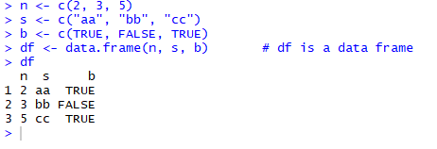
Data Frames
A data frame is used for storing data tables. It is a list of vectors of equal length.
Data frame has the ability to store vectors of different types
Elements in the same column should be of same type
All columns in a data frame should have same length

Slide 23
Adding Row and Column to Data Frame
Adding new column
by using $ sign
people$height <- height # assigning new column to the people data frame and putting the vector as the last column. If the column name contains a space, use double quotes.
by using double brackets
people[["height"]] <- height
by using cbind()
cbind(people,weight) #adding the weight vector as the last column in people data frame

Slide 24
Adding Row and Column to Data Frame (cont.)
Adding new row
New row should be a data frame also
Before adding new row with rbind()improve the definition of the new row
Sorting a data frame
There are 2 function
sort()
With this function, only the selected column will be sorted and returned
order()
Order only the selected column but returns a vector with the ranked position of each element

Slide 25
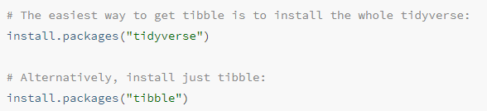
Tibble
Tibbles are a modern take on data frames. they tweak some older behaviors to make life a little easier.
To install the package to use the tibble;

Slide 26
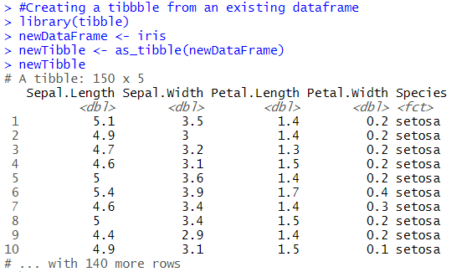
Tibble (Usage)
Create a tibble from an existing object with as_tibble():
This will work for reasonable inputs that are already data.frames, lists, matrices, or tables

Slide 27
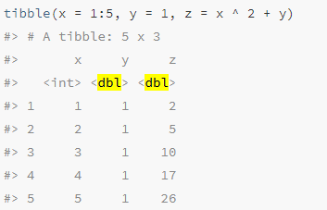
Tibble (Usage)
You can also create a new tibble from column vectors with tibble():

